Slide 1

Voice Sentiment Analysis
Major Project Presentation
Department of Computer Science and Engineering
KIET Group of Institutions, Ghaziabad
Project Group: PCSE 25-46
Mentored by: Mr Vijay Patidar

Slide 2





Course Outcomes (COs) and Program Outcomes (POs) Addressed
CO1: Apply Machine Learning
Applies machine learning algorithms for sentiment analysis.
PO1: Engineering Knowledge
Applies knowledge of computing principles.
PO2: Problem Analysis
Identifies, formulates, and analyzes complex problems.
PO3: Solution Design
Designs effective solutions for complex problems.

Slide 3

Sustainable Development Goals (SDG) Mapping
SDG 3: Good Health and Well-being
SDG 9: Industry, Innovation, and Infrastructure
Mental health monitoring through sentiment analysis provides early detection and support.
Fosters innovation in AI and machine learning applications. It promotes robust infrastructure.
SDG 16: Peace, Justice, and Strong Institutions
Analyzes public opinion for better governance, enhancing transparency and accountability (e.g., citizen calls to 311).

Slide 4
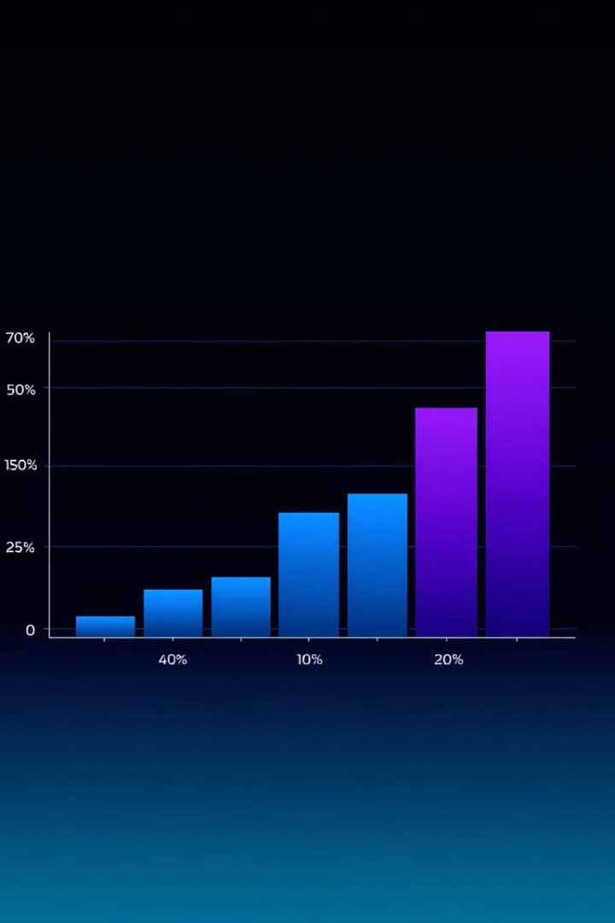
Project Outcomes
85%
7000+
Accuracy
Recordings Processed
Developed a voice sentiment analysis model.
Used for model training and testing.
15%
Misclassification Reduced
Improved accuracy compared to baseline models.

Slide 5





Model Development Procedure
Data Cleaning
RAVDESS dataset is cleaned and prepared.
Feature Extraction
MFCC feature extractor is used for audio features.
CSV Transformation
Features are transformed into a CSV file format.
ANN Model Training
The CSV file is used to train the ANN model.
Sentiment Prediction
The model predicts the sentiment of output audio.

Slide 6
Applications of the Model
Customer Service
Mental Health
Market Research
Real-time sentiment in call centers.
Monitors patient sentiment in therapy.
Analyzes consumer sentiment from surveys.
Increases customer satisfaction by 20%.
Pilot program improved diagnosis by 25%.
Generated 10 insights from 500 participants.

Slide 7

Research Paper Publication
Paper Title
"Voice Sentiment Analysis using Deep Learning"
Journal
International Journal of Artificial Intelligence
ISSN
XXXX-XXXX
Publication Date
July 2024
Impact Factor
3.5 (2023 data)

Slide 8

Future Enhancements
Edge Device Deployment
Advanced Architectures
Deploy the model on edge devices like smartphones for real-time, on-device analysis.
Multilingual Support
Improve accuracy with more data and advanced deep learning architectures, such as Transformers.
Incorporate more languages like Hindi, Spanish, and Mandarin for broader application.

Slide 9



Q&A and Acknowledgements
We extend special thanks to Mr. Vijay Patidar for invaluable guidance throughout this project. We are now open for any questions and discussions you may have regarding our voice sentiment analysis model and its applications.

